Slide 1
Flipkart website automation using selenium and jenkins
Presented by : vasa jothika Ganga
Emp id - 201328

Slide 2
Content
INTRODUCTION
SELENIUM
POM.XML
JUNIT
JENKINS

Slide 3
iNTRODUCTION
This Presentation is about the automating the website using Selenium Tools and shows the process of automation and we can load the site and perform various functionalities using Testing Framework.

Slide 4

SELENIUM
Selenium is an open source , providing a versatile framework automating web applications.Selenium automates web browsers, aiding in functional testing.
Selenium supports multiple programming languages and offers features like navigation and data extraction . The WebDriver component acts as bridge between automation scripts and web browsers , enabling control over browser actions.

Slide 5
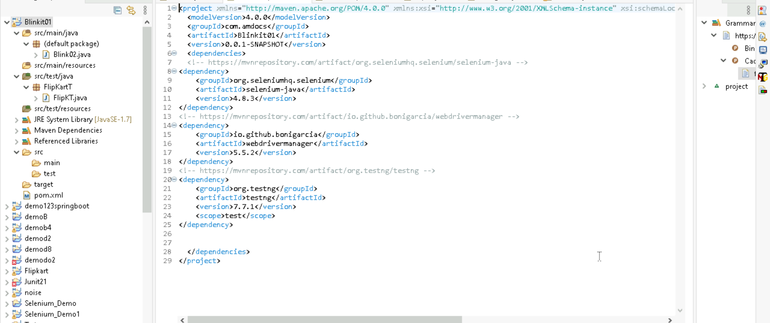
Pom.Xml
In Pom.xml ,Selenium-java and webdrivermanager and testng dependencies are included.

Slide 6
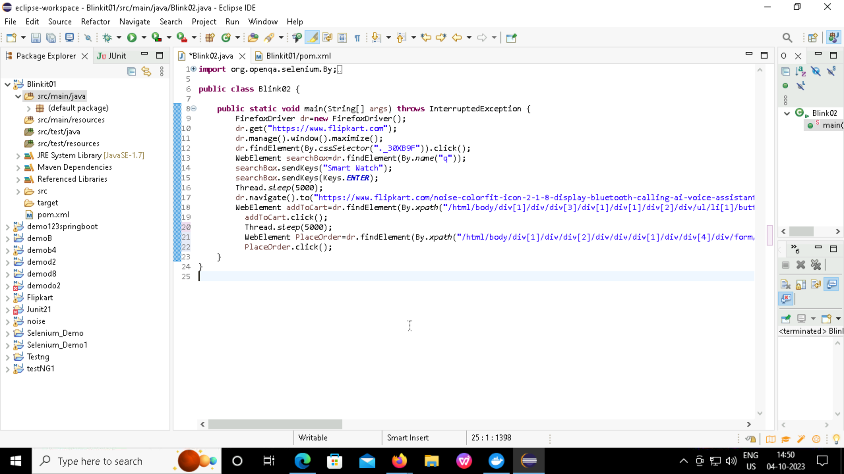
Source Code

Slide 7

Junit
In selenium , Junit is commonly used as at testing framework to write and execute test cases.
Junit provides a set of annotations and assertions that can be used to define and verify the expected behavior of selenium tests.
The org.junit package contains many interfaces and classes for junit test such as assert Test, Before ,After etc…

Slide 8
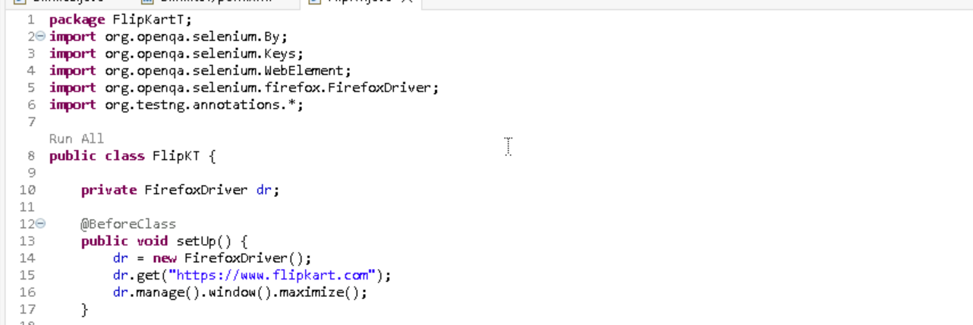
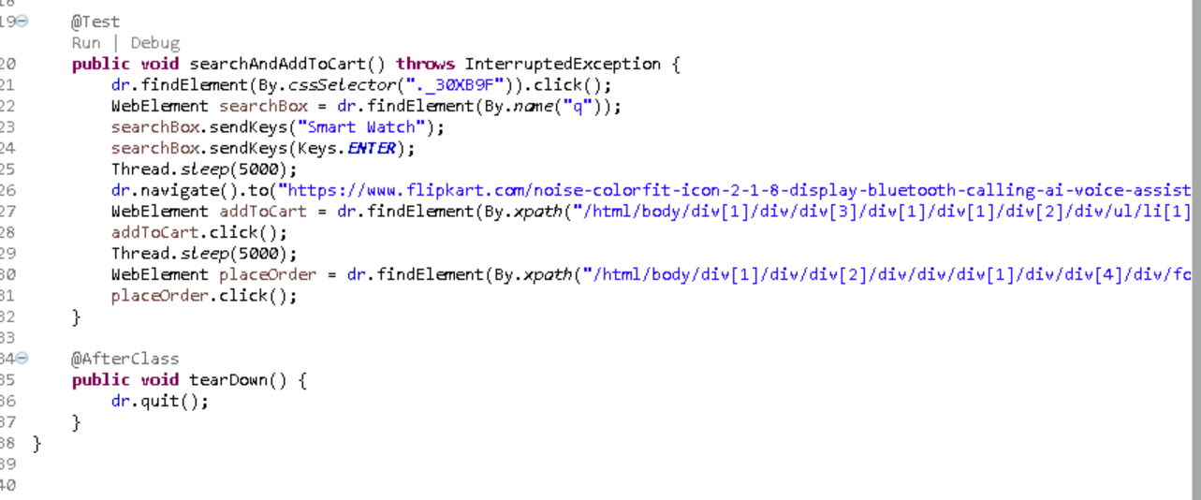
JUNIT TESTING

Slide 9
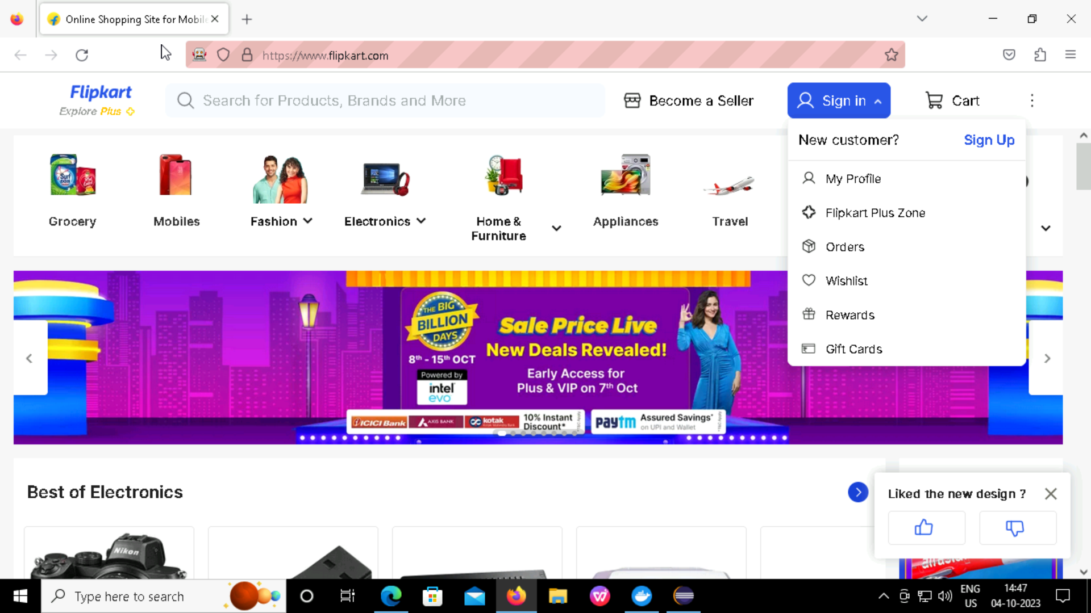
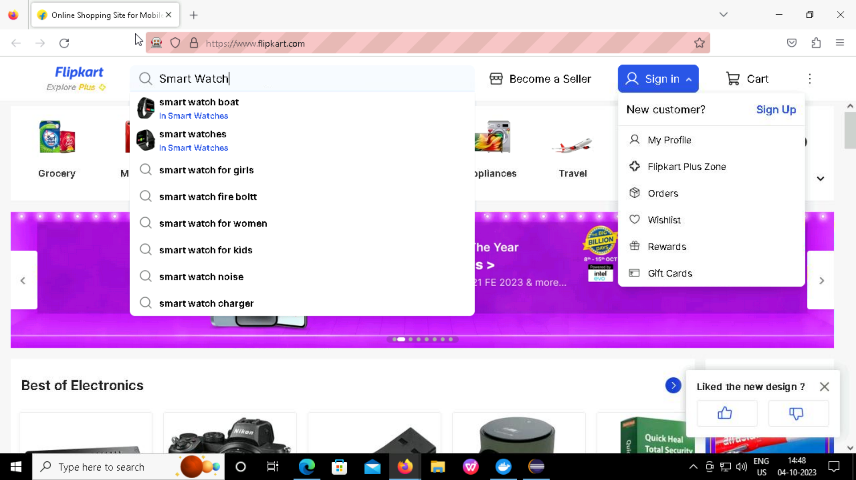
Output

Slide 10
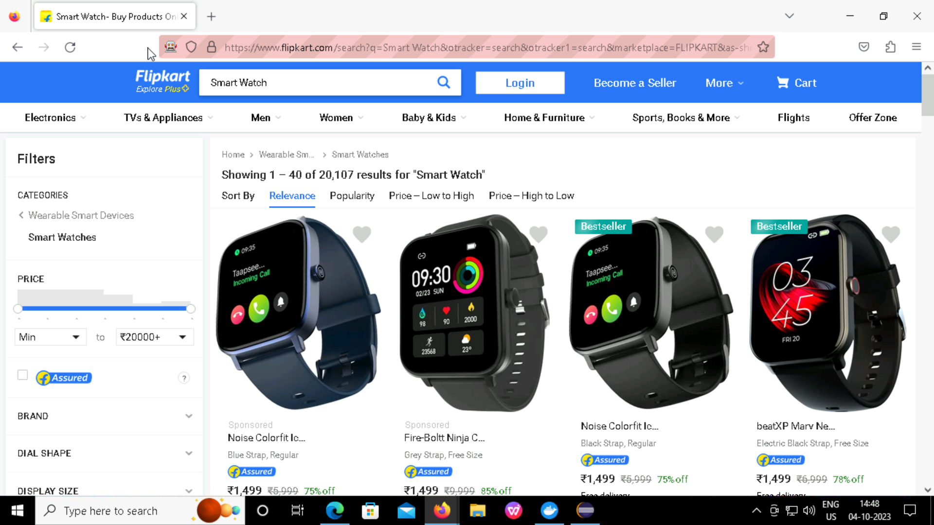
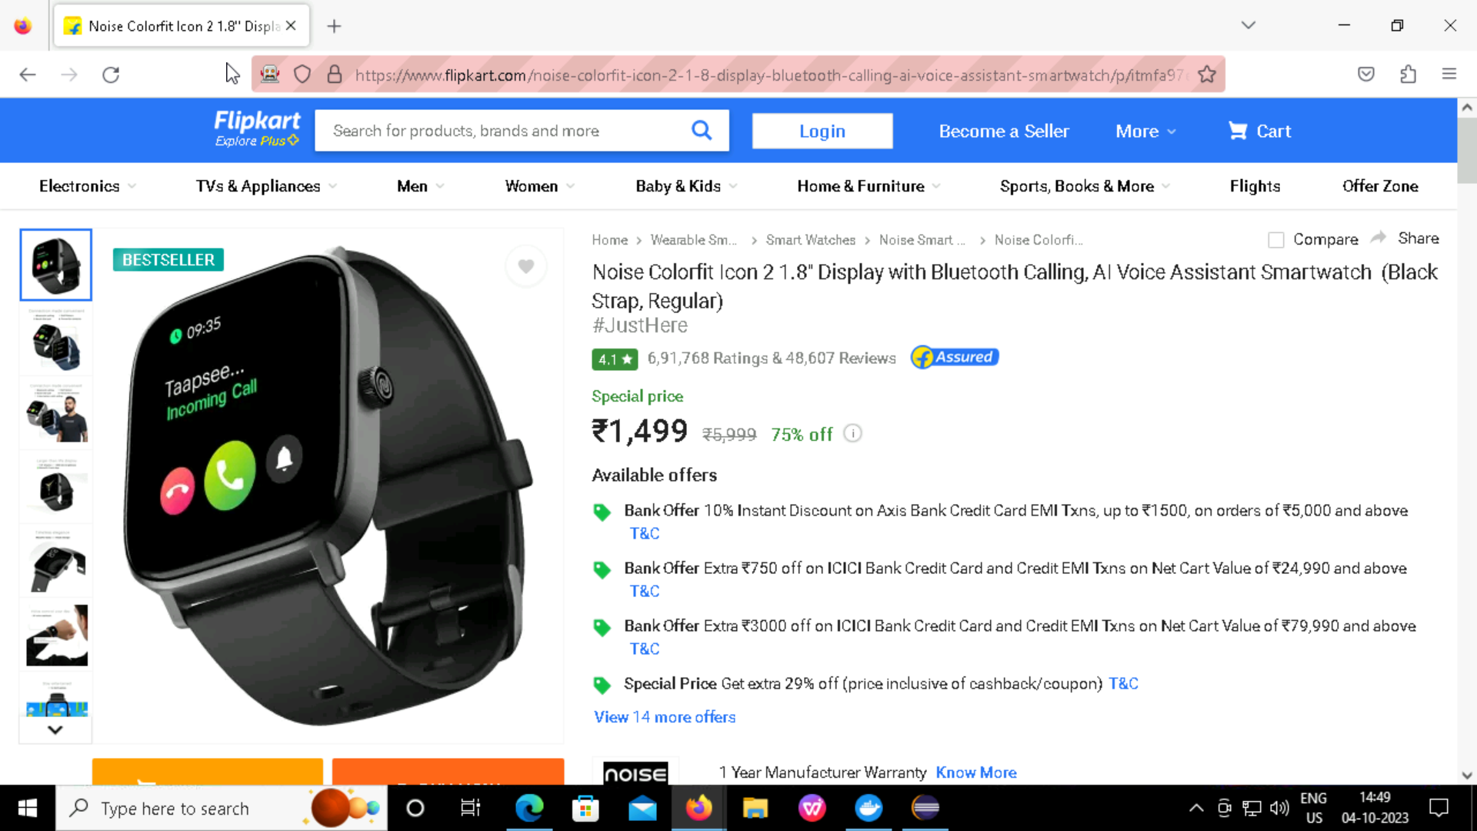

Slide 11
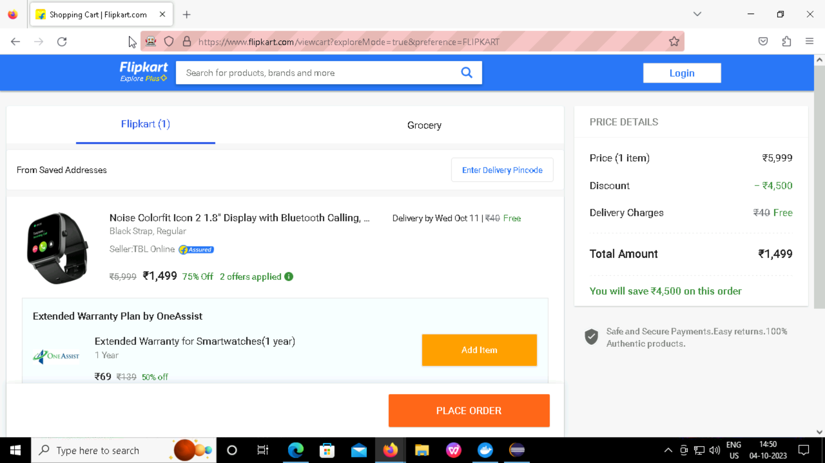
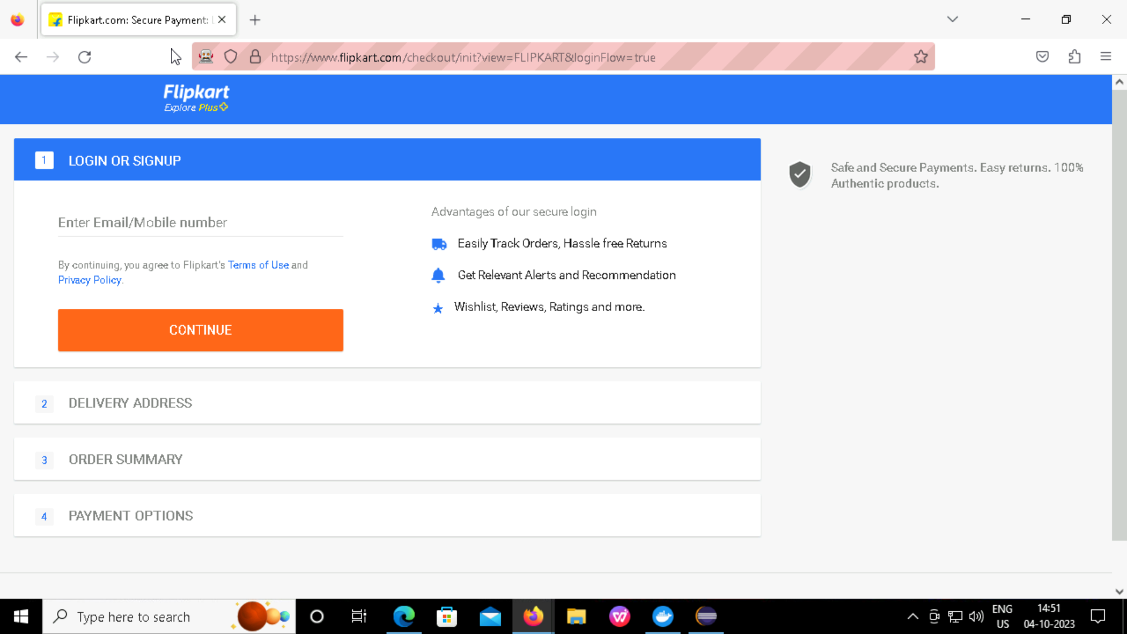

Slide 12

Jenkins
Jenkins is a popular open-source automation server that can be used for continuous integration and continuous delivery (CI/CD) of software projects ,including Selenium tests.
With Jenkins ,you can automate the build , test, and deployment processes of Selenium tests.

Slide 13
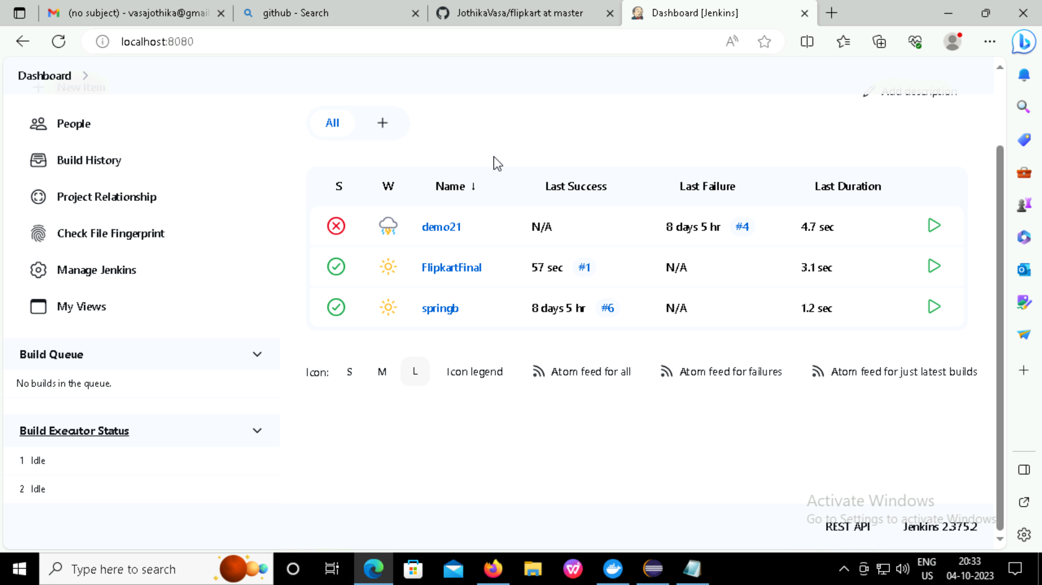
Jenkins Build UI

Slide 14
Thank you

